Slide 1


MINI PROJECT:- Data Management and Accounting Analysis
TEAM MEMBERS-
ADITYA RAJ – 2101331540008
AJENDRA RAI – 2101331540012
DHAIRYA K SINGH 2101331540036

Slide 2
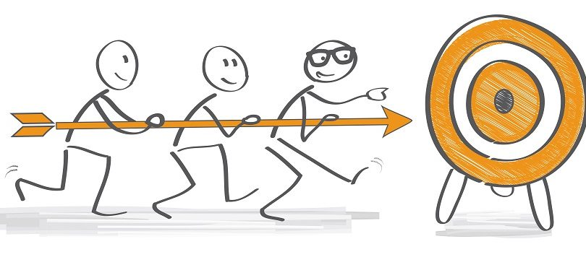
OBJECTIVE:
The objective of the project is to create a segment of banking website that allows user to create, modify and delete their account and admin can manage users account details and can access user transaction details.
The website offers a user-friendly interface that allows customers to easily navigate through the different features of the site. Upon landing on the homepage, customers can choose either open a new account or login to existing account.

Slide 3

PURPOSE:
This mini project could be beneficial for both the bank and its customers. For the bank, it could streamline the application process and reduce the workload of staff responsible for manually processing paper applications. For customers, it could provide a convenient way to apply for account opening and manage their applications online, without having to visit a physical branch.

Slide 4

METHODOLOGY:
Requirement Analysis: In this step, the requirements for the banking website should be identified.
System Design: In this step, the system design for the banking website should be created. The design should include the database design.
Development: After the system design is created, the development of the banking website can be started. The development can be done using various web development technologies such as HTML, CSS and backend technology like Django (Python-based web framework).
Testing: Once the development of the website is completed, it is essential to test the website to ensure that it is free from any bugs or errors. Testing can be done using various testing techniques.
Deployment: After the testing is completed, the website can be deployed to the production environment.
Maintenance: After the deployment of the website, it is essential to maintain the website regularly to ensure that it is running smoothly and is up-to-date with the latest security patches and updates.

Slide 5

Technologies:
HTML - HTML is the stands hypertext markup language for documents designed to be displayed in a web browser. We used this language because HTML is a simple language to learn and understand, it is free, no special software is required, HTML is supported by nearly all browsers worldwide such as Google, Safari, Opera, etc., In comparison to other web programming languages on the market, HTML is one of the most user-friendly search engines and HTML is a lightweight markup language that loads quickly.

Slide 6
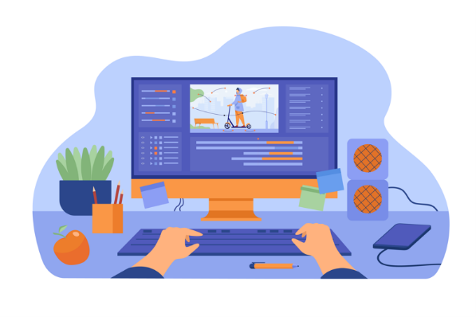
CSS - Cascading Style Sheets (CSS) is a simple mechanism for adding style (e.g., fonts, colors, spacing) to Web documents. We used this language because of its faster page speed, Better User Experience, Quicker Development Time, If you need to change the format of a specific set of pages, it’s easy to do so with CSS. There’s no need to fix every individual page. Just edit the corresponding CSS stylesheet and you’ll see changes applied to all the pages that are using that style sheet, Compatibility Across Devices.

Slide 7

NEW ACCOUNT OPENING:
For new customers, the website offers an online account opening form that they can fill out to initiate the account opening process. The form collects information such as the customer's name, address, contact information, and other relevant details. Once the form is submitted, the website sends a confirmation email to the customer's email address, and the account opening process begins.
For existing customers, the website provides options to update their account information, including their contact details, mailing address, and other relevant information. Customers can also insert new account details. The website also offers the option to delete an account if the customer no longer needs it.

Slide 8

CONCLUSION:
In conclusion, the development of a banking website for account opening page (with features of insertion, updation, and deletion) is feasible and can be done by following a step-by-step methodology. The website should be user-friendly, secure, and comply with all legal and ethical requirements. The development process should include requirement analysis, system design, development, testing, deployment, and maintenance. Regular maintenance and updates will help to ensure that the website is up-to-date and secure. Overall, the banking website will provide convenience to customers and improve the efficiency of the banking system by allowing account opening, updation, and deletion to be done online.

Slide 9



THANK YOU

